Slide 1

Cross-Platform Mobile Development in Visual Studio
Notes:
Thanks for coming along.

Slide 2
Who Am I?
Bart Read, Software Engineer, Red Gate Software
Working on Nomad for Visual Studio - http://vsnomad.com/
bart.read@red-gate.com
Twitter: @bart_read
https://github.com/bartread

Slide 3

Notes:
Red Gate’s been around for about 14 years now. We’re based in Cambridge in the UK, but also have offices in Pasadena and Singapore.
Originally we became successful making tools for SQL Server, and in fact we still do this: things like schema and data comparison and synchronization, backup, SQL intellisense.
We’ve also built a successful business around .NET developer tooling with, for example, two of the best profiling tools out there.
More recently we’ve moved into cloud tooling, and of course we also have a mobile offering.
Nomad for Visual Studio is a Visual Studio extension, and corresponding service, which allows you to build cross-platform mobile apps for iOS and Android from within Visual Studio.
And it’s at this point that I have to make a disclaimer, and the disclaimer is this: I obviously have an opinion, and potentially an agenda. I am going to try and subvert that opinion and that agenda as much as possible throughout this talk to give you as balanced and fair an overview of mobile development in Visual Studio as I can. This talk isn’t an advert!
One last thing before we get into it: if you have any questions I’m happy to take them as we go along, so please just call out or raise your hand. Obviously if it gets too in depth or off topic I might say let’s deal with it at the end, or talk after the session.

Slide 4
Notes:
I’m not going to labour the point, but this is why…

Slide 5
Notes:
And here are the figures by operating system.
It’s a similar growth story for tablets - you already know this.
Usefulness in business:
- Looking things up - addresses, navigation, facts and figures
- Meeting agenda and notes
- Document sharing/viewing
- Content consumption rather than creation - but this is changing
- Communication - phone, skype, hangouts, email, messaging services, etc.
- Network provisioning/mobile access point
- Presentation notes! (Rather than cards, presenter view in Powerpoint, etc.)

Slide 6

BUSTED!
Notes:
Of course, as useful as these things are, they can be a distraction...

Slide 7





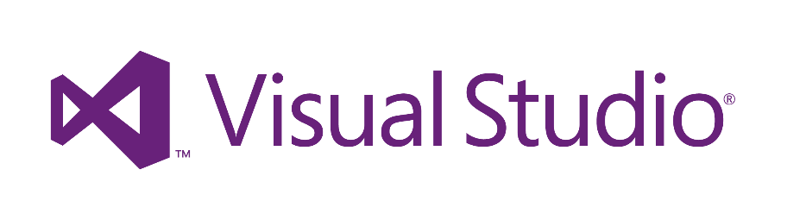


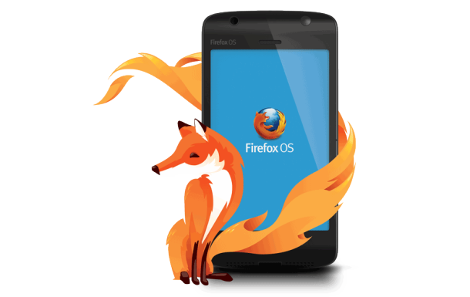


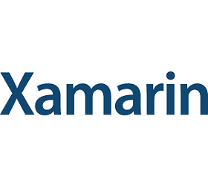



Notes:
There are many different options available for mobile development, some more applicable to different use cases than others.

Slide 8
These options all boil down to…
Native
Hybrid
Mobile Web
Other/Fringe/Exotically Proprietary
Notes:
They basically boil down to:
Native – i.e., developing for iOS with Objective C and XCode, Android with Java and either Eclipse or IntelliJ, or even Xamarin, which really falls somewhere between native and hybrid
Hybrid – apps built with web technologies packaged in a native wrapper – these are the kind of apps you’d build with Nomad
Mobile Web – literally just building a mobile optimised version of your website with technologies such as jQuery Mobile, and often employing responsive web design techniques to better handle different form factors
Other/fringe/exotically proprietary – an example here would be something like Appcelerator Titanium, where you’re writing JavaScript but it’s against Titanium’s proprietary APIs and is ultimately compiled down to native code

Slide 9
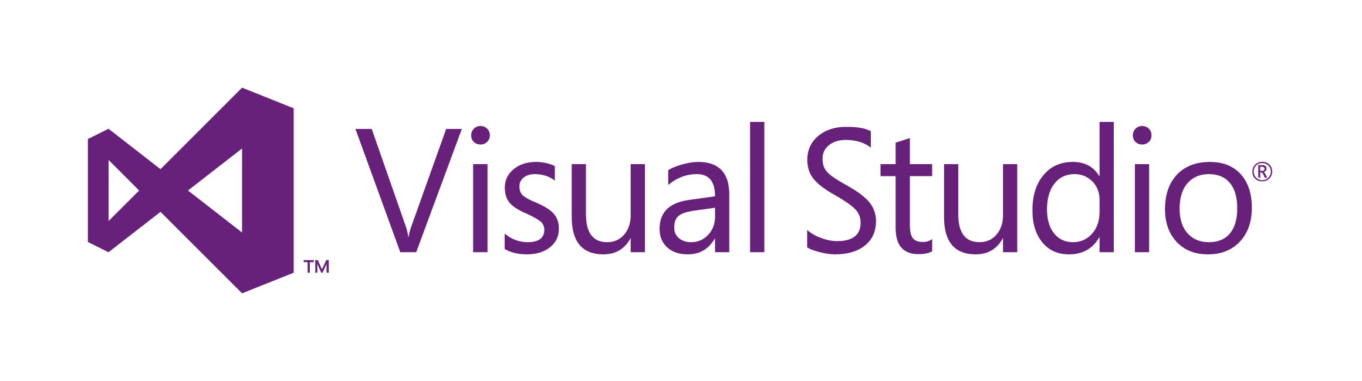
Notes:
I have an easier job here today though because I’m talking only about the options available in Visual Studio, of which there are only two at present:
Nomad, the hybrid solution that I work on, which supports iOS and Android
Xamarin, which allows you to build native apps for iOS, Android and WP8 using C#
Soon I expect Telerik’s Icenium will also feature, though goodness knows how I’m going to shoehorn a third option into this talk without it turning into some sort of horrific 3 hour epic Hollywood/Powerpoint chimaera.
(You can also roll your own solution by locally installing PhoneGap/Cordova or using PhoneGap Build, and develop your app in Visual Studio, but you’re not going to get any advantage from using VS over any other IDE in this situation, except perhaps familiarity, because there’s no integration between Cordova or PhoneGap Build and VS.)
But hold on: why would you want to use Visual Studio anyway when you have all these other options available?
I suppose what I’d say is that if you’re not already using Visual Studio, and don’t plan to for other work, then feel free to choose one of the other options that suits you better.
But if you’re a Visual Studio developer - how many of you are? You’ve already got a significant body of work in Visual Studio: solutions, projects, web apps, services, etc. And the mobile app you’re planning to develop is probably a complement to some portion of that body of work.
And you’re used to Visual Studio and all it has to offer: projects, powerful editors, intellisense, relative ease of use, debugging, and all that good stuff.
Why wouldn’t you want to develop in Visual Studio when moving to another toolset is just going to slow you down?
(I suppose Douglas Coupland’s concept of “option paralysis” – from Generation X – is helpful here too. Your job is going to be a hell of a lot easier if you can quickly whittle the extensive list of available choices down to only a few options.)

Slide 10
Notes:
OK, so let’s talk about these two options, Xamarin and Nomad. I’ll deal with Xamarin first.
Well… Xamarin are obviously a competitor of ours but I’ve got a lot of respect for them: they have some genuinely cool tech and, for some requirements are absolutely the obvious choice.
Xamarin rose from the ashes of Attachmate’s acquisition of Novell, which saw them let the entire Mono team go. I don’t know how that felt for Miguel and the Mono guys but, from the outside, at the time it looked like a terrible thing. Arguably though it’s turned into a blessing in disguise.
Xamarin allows you to write cross-platform mobile apps for iOS and Android in C# using Visual Studio, or their own Xamarin Studio IDE. Since we’re interested in Visual Studio we’ll ignore the latter.
Although the Windows Phone libraries aren’t part of Xamarin - you need the Windows Phone SDK from Microsoft, obviously - because you’re writing in C# you can still share code between your iOS, Android and WP8 apps.
Your business logic, data layer, services layer, and other app backend components are shared between all versions of your app - or at least they are if you get your architecture right! The UI however is platform specific.
Xamarin gives you access to the complete set of iOS and Android APIs by exposing through standard .NET namespaces. It also provides tooling such that you can generate .NET bindings for any third party iOS or Android libraries you might want to use. You can think of Xamarin as providing a thin wrapper around the native APIs whereas, in contrast PhoneGap/Cordova, which I’ll get to shortly, abstracts them away entirely.
Now, whilst you’re writing code for all three platforms (potentially), and probably in a single solution, in C#, the way that code is built, packaged, deployed, and run for each of the supported platforms is quite different.

Slide 11
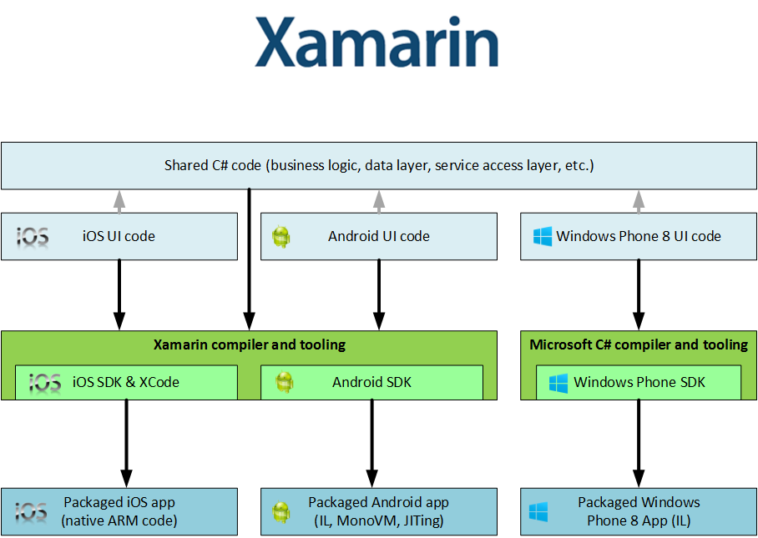
Notes:
iOS
For iOS the Xamarin compiler cross-compiles straight to ARM code, and the linker uses static analysis to eliminate unused types from the final deliverable - this really shrinks it down because you’re not having to include the entire .NET framework, along with a load of code you’re just not using.
It does impose some limitations on the language features you can use though, mostly around generics. You can use generics, but some things won’t work - Xamarin have extensively detailed these limitations on their site.
Apple don’t allow any code generation at runtime, so this means that things like System.Reflection.Emit, and anything built on it (like the DLR and any DLR languages, along with a load of other stuff) also won’t work.
All of this adds up to a cut down version of the .NET API that’s mostly equivalent to the core Silverlight APIs (NOT the UI controls, obviously), with a few extra bits tacked on. Nonetheless, many third party libraries are compatible Xamarin and can still be used - e.g., SQLite.
Android
Android is somewhat different: the code is compiled to IL, and then packaged up with MonoVM and JITing support. The Android native APIs are used via JNI. Again the linker prunes out any code that isn’t used via static analysis. As you’d expect, anything access purely reflectively will be missed by it.
There are again limitations, which are different from the iOS limitations, as you’d expect. For example, there is some partial support for DLR. Not entirely surprisingly there are (somewhat different) limitations with generics.
Again, these are all well documented on the Xamarin site.
WP8
Windows Phone is supported by the Visual Studio tooling and the Windows Phone SDK. .NET assemblies are built from your code and run in the core .NET runtime common to both WP8 and W8, so everything should behave as you’d expect.
Clearly there’s the potential for the platform differences I’ve mentioned here to lead to differences in behaviour and subtle, or not-so-subtle, bugs on different platforms, which is something you need to be aware of.

Slide 12
Pros
Cons
C#
Native look
Near-native performance
Full access to native APIs
More code; less sharing
Maintenance
Need to know native APIs
Platform quirks
Need Mac to build for iOS
Use for: performance, native experience
Notes:
So there are some definite advantages to this approach:
- You get to code in C#, which is a great language,
- Your app will be indistinguishable from a native app, particularly if you’ve taken the trouble to follow the UI style guides for each platform,
- You should get near-native performance,
- You have full access to the native APIs so can take full advantage of device capabilities,
There are some downsides though:
- You’re going to have to write more code - UI code can’t be shared
- The platform specific code leads to additional maintenance overhead; if you architect your app wrongly you can find yourself in a position where very little code is shared between platforms
- You need to know the native APIs for each platform you want to support
- Language limitations and quirks between platforms could trip you up - in practice, is this likely to be any worse than the kind of issues that can occur when everything’s hidden away behind an abstraction layer like Cordova? Probably not – it’ll just be different
- You need a Mac to build for iOS, even if you’re developing your app in Visual Studio.
So when should you use Xamarin?
- When native, or near-native, performance is critical - though you should ask yourself whether you really need to be doing this much heavy lifting on device, because it will pummel the battery life.
- When you absolutely positively need to offer a platform specific experience indistinguishable from a native app; arguably for business apps this may be never, because you may be better served (and serve your users better) by offering a common experience across platforms.

Slide 13


Notes:
Moving on, I’ve mentioned PhoneGap (or Cordova) and the fact that Nomad is built on it quite a few times now without really explaining myself.
Let’s start with a bit of history.
Some years back a company called Nitobi developed a technology called PhoneGap, which allowed developers to build mobile and tablet apps using front-end web technologies: HTML5, JavaScript, CSS.

Slide 14
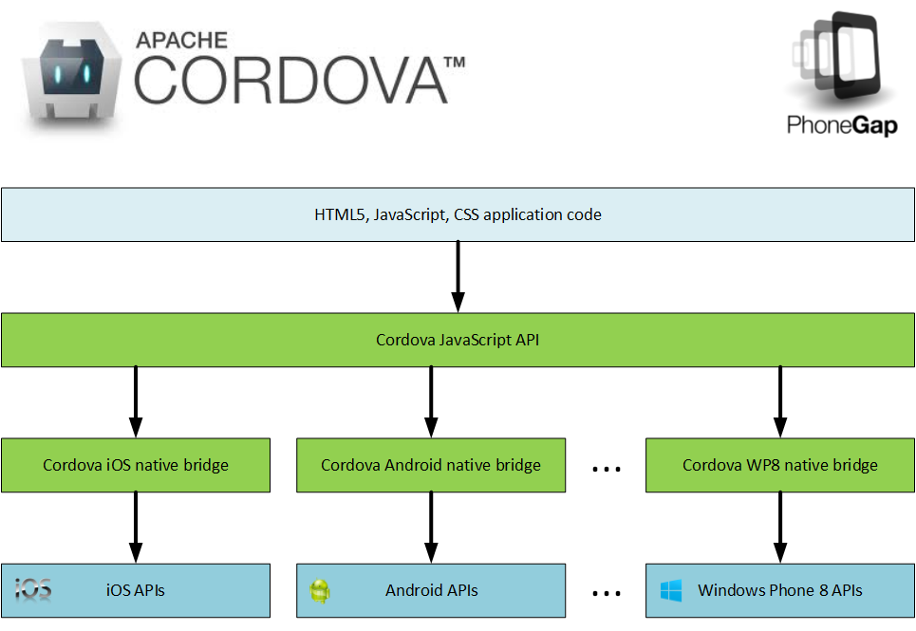
Notes:
PhoneGap works by abstracting native device APIs in an OS specific native layer that exposes a common cross-platform API through JavaScript. This means that you can use the same API to access camera, contacts, accelerometer, sound capture, compass, GPS, along with other device functionality regardless of whether you’re writing an app for iOS, Android, Blackberry or Windows Phone.
Apps built with PhoneGap are known as hybrid apps because they are always a hybrid of a native wrapper or shim within which your HTML5 and JavaScript runs, inside the platforms native web view. Nowadays when people talk about hybrid they generally mean that everything about the app that makes it the app is written in HTML5 and JavaScript, and the native part is all provided by PhoneGap - i.e., it’s just the wrapper and framework within which your app runs.
However, PhoneGap also allows you to write an app using native code that includes embedded web components for some functionality. I’d suggest this is where the term hybrid really comes from. Nowadays when I write a mobile app I’m only working with web technologies and don’t generally care at all about the native parts - PhoneGap handles that all for me.
OK, so that explains PhoneGap, but what’s this Cordova thing?
Some time after Nitobi began developing PhoneGap, they were acquired by Adobe. Adobe then open sourced PhoneGap and handed over to The Apache Software Foundation, but kept the PhoneGap trademark. Thus, PhoneGap is now known as Cordova. Think of it as being the same as the relationship between Linux and, say, Ubuntu - PhoneGap is like a branded distro of Cordova.

Slide 15
The Cordova JavaScript API
Accelerometer Camera
Capture Compass
Connection Contacts
Device Events
File Geolocation
Globalization InAppBrowser
Media Notification
Splashscreen Storage
Plug-ins: http://plugins.cordova.io/
Notes:
Here you can see all the device APIs that Cordova supports, most of which are fairly self-explanatory.
If you follow the plug-ins link you’ll find dozens and dozens of plugins that extend Cordova’s base functionality. I should say that many of these are VERY specific functional extensions that you won’t need, although there are a few commonly used ones such as PushNotification and BarcodeScanner, that you’ll quite likely want.
As of today most plugins haven’t yet been updated for compatibility with Cordova 3.0, however Adobe have told us that they’ll be updating the plugins they curate – which include most of the commonly used plugins – over the next few weeks so you should expect to be able to use them with Cordova 3.0 projects soon.
In my view Adobe deserve a lot of props for their support of the Cordova ecosystem: they still employ a team to work on Cordova and its plugins full-time, which is great for the mobile development community.

Slide 16
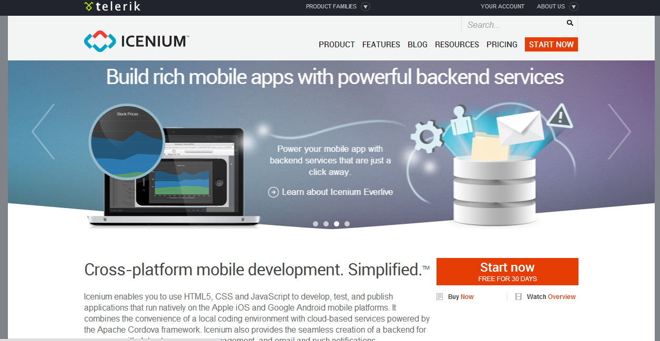
Notes:
This is where Nomad and Icenium. Nomad is a solution for creating cross-platform mobile apps built on top of Cordova from within Visual Studio. It supports both iOS and Android, and will soon support Windows Phone 8 as well. As I said, Icenium does the same and also currently supports only iOS and Android.

Slide 17
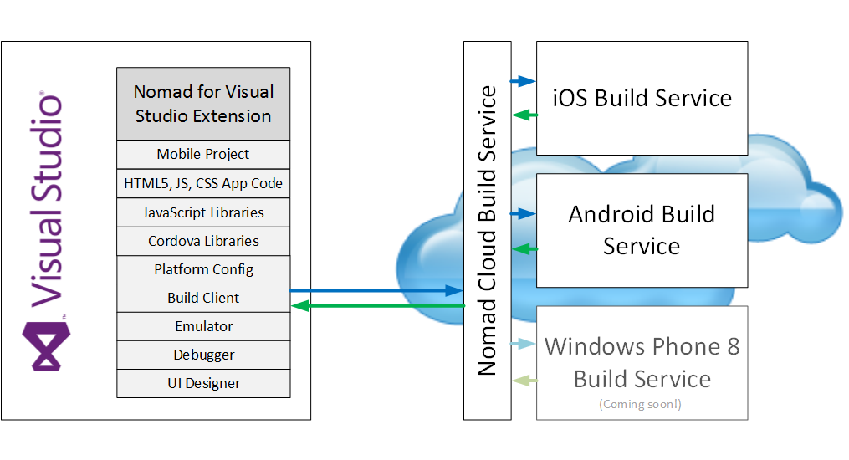
Notes:
Nomad comprises a Visual Studio extension and cloud build service that allows you to build for supported platforms without needing to do any complex configuration, set up your own build system, or buy any expensive Apple hardware.
You write your code in Visual Studio and, when you press build, it’s packaged up and sent to our web service. Behind the scenes your code is build in the cloud, packaged up into an APK for Android or IPA for iOS, and sent back to you. It’s then written to a directory of your choice. Often people will use their build output folder, but you could also set it to a Dropbox or Skydrive folder for easy deployment of your app to Android devices – I’ll demo this in a minute.

Slide 18
Pros
Cons
HTML5/JavaScript/CSS
Write once for all platforms
Simple, unified device API
Simple setup
Don’t need a Mac*
Future-proof; no lock-in
Non-native UX
Performance
No great Windows solution**
Use for: simplicity, delivery time, maintenance
Notes:
So, the pros and cons of using Nomad are pretty straightforward…
On the plus side…
HTML5/JavaScript/CSS –> you get to use the web technologies you’re most familiary with
Write once for all platforms -> lower development and maintenance costs
Simple, unified device API -> less to learn, easier to get up and running
Simple setup -> no SDKs, Xcode, Cordova and build configuration – just a simple VSIX file to download and install in VS to get up and running
Don’t need a Mac*
Future-proof; no lock-in -> you’ll be able to easily migrate to a Mobile Web app in future with no/minimal work required, whilst still having access to great functionality in Nomad such as on-device debugging
And on the downside…
Non-native UX -> this goes beyond just the look of the app to the “feel” as users interact with it. OTOH does this really matter in a line of business app, or are there more important concerns? Also worth noting that there are very successful apps built with Cordova in both the iOS app store and Google Play
Performance -> If you need to do a lot of heavy-lifting on device then Cordova isn’t going to work well for you. But remember to ask yourself why you need this? Could you offload it onto your server if your app runs always connected?
No great Windows solution**
*You will in theory need a Mac to publish to the iOS app store. In reality you can use a service such as http://www.macincloud.com/, which costs $1/hour for their pay as you go service, to rent the use of a Mac in the cloud for long enough to go through the publishing process. The publishing wizard doesn’t take that long to run through, but the approval process can be quite slow so don’t hold your breath to hear back from Apple!
**I’ll talk more about Windows Phone 8 and Windows 8 development in a moment: unfortunately there really aren’t any great solutions for this at the moment.
TODO FOR NEXT TIME: Add some shots of well-known (and good looking) apps built with Cordova to offset that “non-native UX” con – the real ale app is a great option here.

Slide 19

But wait: why not just use mobile web instead?
Notes:
That’s a pretty fair question.
In the long term I think this is where things are going. The web will win: just look at what Mozilla are doing with FFOS where websites start to behave a lot more like apps and can work offline/disconnected.
The problem at the moment is that websites can’t generally access device functionality, especially not where there are potential privacy issues - so, for example, contacts, camera, sound capture, location services, and so forth are problematic areas.
If you don’t need any device functionality, and you only want your app to work connected then you certainly could go down the mobile web route.
I’d still recommend a Cordova based solution though because it gives you a lot more flexibility. Also, one of Cordova’s stated aims is to become obsolete - one day you won’t need it at all any more and, for apps that are built on it, it will exist as only the thinnest of thin wrappers over device APIs standardised by the W3C. This is already happening - for example, in Cordova 3.0 now exports the W3C connection API in addition to the now deprecated navigator.network.connection API.
Ultimately you will have to do ALMOST NO WORK to move from a Cordova-based application to a Mobile Web application when you no longer need Cordova to access device functionality.
Of course, native and hybrid apps will still exist for some use cases - sometimes you just need the performance, or more advanced control over device functionality, such as the camera or sound capture - but for many, even most, apps mobile web will be the way to go.

Slide 20
Windows Phone 8 and Windows 8/RT Development Resources
http://bit.ly/1efcr1d - Windows Phone 8 and Windows 8 platform comparison (MSDN)
http://bit.ly/18WA7oU - Windows Phone 8 and Windows 8 app development (MSDN)
http://bit.ly/GQuOxU - Handling Windows Phone 8 and Windows 8 platform differences (MSDN)
http://bit.ly/1605aCh - Building Apps for Both Windows 8 and Windows Phone 8 Jump Start (Channel 9)
Notes:
(Summarise this better – I decided to give a much shortened version in the talk.)
This was last on my list because, as we’ve seen, it has a pretty small market share (although growing), but the situation is different than for iOS and Android development, and I want to make you aware of some of the gotchas.
Certainly I believe that for corporate DevOps, Windows Phone 8 in particular is going to grow in importance - remember the data shows it’s already moved into 3rd place, ahead of Blackberry. Windows 8 on tablets? Jury’s still out, although in the long run I’ve no doubt it will make inroads.
(Also, the headline data doesn’t necessarily tell the whole story - the Android market is colossally fragmented due to the plethora of devices across price points, which all have differing capabilities.)
WP8 and W8 development is frustrating because for people already working in Visual Studio W8 and WP8 development ought to have a nice solution. That solution ought to be something like, “MIcrosoft provide everything you need out of the box with Visual Studio”, or, “hey just download this SDK and you’re good to go.”
Unfortunately it isn’t so, if you want to develop for both platforms, you have a set of slightly crappy options to choose between.
If you develop an iOS or Android app for phones, that app will also work fine on tablets. You might want to make some changes to your interface to account for the higher resolution (depending on hardware generation) and physically larger screen. But at the bare minimum, with no extra effort you can ship an app that will work on both phones and tablets - and that’s probably fine for an initial release, which is going to simplify delivery. You can then make changes to account for the different form factors later and do it with some confidence because you’ll be able to make changes based on user feedback.
With Windows Phone 8 you cannot easily expect to take your app and build and run it unmodified for Windows 8. This is because phones run Windows Phone 8, whereas tablets run Windows RT or Windows 8. These are different operating systems. They have different APIs, and you are almost certainly going to have to write some platform specific code and take steps to ensure that when you architect your app you do so in such a way as to maximise code sharing.
I say almost certainly because you do have the option of using PhoneGap/Cordova - more on this later - but none of the Visual Studio enabled Cordova development options yet support either Windows Phone 8 or Windows 8. That includes Nomad, and that means you’re on your own: you need to integrate Cordova builds into your own CI process, which is non-trivial. I’d been under the impression that PhoneGap Build would be able to help here, but it only supports Windows Phone 8, even though PhoneGap/Cordova itself supports both Windows 8 and Windows Phone 8.
On the plus side, as has been demoed at //BUILD/, for example, there’s usually not that much work to get a C#/VB WP app running on W8’s Modern UI - formerly known as Metro. The changes are often quite small, but you do need to create a separate build of your app. The biggest issues are likely to be in the UI - controls are similar (but different), and reside in different namespaces (System.Windows.Controls for WP8 and Windows.UI.Xaml.Controls for W8).
With web technologies the story is a little grungier. Whilst you can develop for Windows Phone 8 using HTML5, just as you can for Windows 8 and Windows RT, you can’t do it purely using HTML5. There has to be some C# and a little bit of XAML in there. I’m not going to talk about this in detail but see https://github.com/matthiasxc/WP8-HTML-Tutorials for tutorials.
Now, in fairness to Microsoft, they are totally aware of this issue - I’ve put some links on the slide. The bottom line is you need to make sure your UIs are separated out, but you should be able to share most other code. They recommend solutions such as conditional compilation, inheritance, interface polymorphism, and partial classes, along with MVVM, to deal with platform-specific code.
You may already have heard of their “one platform” vision. In the end this should go much further than, for example, Apple who share the same OS across phones and tablets but have a different OS for computers. And they’re already making great strides moving towards it. For example, both WP8 and W8 now share the same NT kernel. In addition they also export a common native API, a common Windows Runtime API, and share the same CoreCLR .NET engine.
If you’re a .NET or web developer this may not help you much right now, but it should give you confidence that as time goes on it will become easier to develop for WP8 and W8 in parallel. I suspect it won’t be too long before you can deploy one app for both - it’s really the only logical conclusion.
As I say, it’s the UI where things get messy: the XAML components are similar but different, and the “native” HTML5 development story for WP8 isn’t fantastic.
OK, I’ve covered a lot of ground there, so let’s just run through the options quickly for WP8 and W8.
You could use Xamarin to build for both WP8 and W8, but that’s not really going to help you with the UI. OTOH, if you’re using Xamarin for iOS or Android already this is the best choice.
If your only concern is supporting W8 and/or WP8 and you haven’t already committed to a solution then use Visual Studio plus the Windows Phone SDK, separate your UIs, and create separate builds.
If you want to support WP8 in addition to iOS and Android I’d recommend a Cordova-based solution. If you need the WP8 solution right NOW you’ll need to go with PhoneGap Build or roll your own. What I’d recommend is you develop and deploy for iOS and Android first, then buid for WP8 later, by which time offerings such as Nomad will either support, or have a much firmer roadmap for supporting WP8. Remember also that as far as build goes you are not locked in. If the unthinkable happens, and we decide never to support WP8 you can create your own build infrastructure for your app, or move to PhoneGap Build. You’ll obviously lose out on the value we add in Visual Studio, like on-device debugging, but you’re not locked in.
If, in addition to iOS, Android, and WP8 you absolutely positively have to support W8 well, then it gets a bit messy. I’d still probably recommend a Cordova-based solution, but you’ll need to think about how you want to build for W8 - I’d go with rolling my own W8 Cordova builds although, again, it’s a bit mucky.
As far as Nomad support for WP8 and W8 goes, WP8 support is one of our most requested features - in fact it’s currently right at the top of our uservoice - but nobody’s mentioned W8. WP8 support is on our roadmap and will ship soon but:
(i) it still represents a very small portion of our userbase - hugely behind both iOS and Android, and
(ii) there’s still some debate on the team as to what constitutes WP8 support: do we just build exactly the same app as for iOS and Android? That makes sense for a first cut, but what about the UI differences, which are much more significant than those between iOS and Android. It’s certainly possible to skin for Modern UI...
SLIDE: Modern UI CSS resources
http://jqmetro.codeplex.com/
http://aozora.github.io/bootmetro/
http://metroui.org.ua/
http://code52.org/metro.css/
http://talkslab.github.io/metro-bootstrap/
...but there are differences in user-interaction as well. It seems unlikely that it will be possible to avoid any platform specific code for WP8.
As for W8, my feeling is that we should probably support this at or shortly after WP8. Sure, not that many people are using it yet, but:
I think Microsoft will make a success of their tablet business in the long term (despite all the commentary otherwise - look at XBOX, for example - they’ll play the long game),
I think the crappy development story thus far may have hurt Windows RT because, unlike iOS and Android, the apps simply aren’t there,
I think people who use apps on WP8 will naturally want to have access to the same apps on W8/RT,
I think W8 will be important in the corporate space, and that people will expect LOB apps to run on it.
This is a personal opinion however and does not necessarily represent the point of view of the Nomad team or of Red Gate itself. Watch this space.

Slide 21

Demo Time!
Notes:
OK, so I’ve given you an overview of the issues you need to consider, and talked you through the possible options, so I think it’s probably time to look at some code.
This is the bit you’ve all been waiting for but the bit that I’ve been secretly dreading, because there are three things I can’t do whilst people are watching me…

Slide 22

Notes:
Parallel parking

Slide 23

Notes:
Peeing

Slide 24

Notes:
And, key point here, typing.
Wish me luck!

Slide 25
App Store Publishing
Notes:
There are obviously the standard app stores: the iOS app store, and Google Play. But what if your app’s meant only to be used by people in your company?
For Android you can obviously just allow people to download and install it, but then you have to worry about updates. A better approach might be to publish it to the Google Play Private Channel for Google Apps: http://support.google.com/a/bin/answer.py?hl=en-uk&hlrm=en&answer=2494992.
For iOS there’s the iOS Developer Enterprise Program, specifically for distributing in-house apps: https://developer.apple.com/programs/ios/enterprise/. There are also other unofficial options, such as TestFlight. Apple also offers the Volume Purchase Program for Business, which allows you to privately distribute B2B apps, which can be paid for or free: https://developer.apple.com/programs/volume/b2b/.

Slide 26
Coming soon to Nomad…
On-device debugging
A FREE version of the service
Cordova plug-in support (already in Icenium)
PushNotification
BarcodeScanner
Etc., see http://plugins.cordova.io/
Windows Phone 8 support
Notes:
Keep an eye out for this cool new functionality coming to Nomad soon.
We’re REALLY excited about the on-device debugging, which will allow you to debug code running on any iOS or Android device. In theory we could extend this so that you could debug on any device running anywhere in the world – think about what that could do for field support!

Slide 27
Contacts & Resources
Nomad for Visual Studio - http://vsnomad.com/
bart.read@red-gate.com
Twitter: @bart_read
Slides (GitHub): http://bit.ly/GQtGuc
Using Nomad to create an app with Azure Mobile Services (CodeProject): http://bit.ly/GHMA5N
Notes:
OK, so in conclusion, the cross-platform mobile development market is still immature and evolving rapidly - offerings are incomplete and compromises at some level are inevitable. Your best options for working in Visual Studio are Xamarin or web technologies using Nomad.
If you absolutely positively need native performance then you should use Xamarin. We think most apps don’t need this, certainly most line of business apps don’t need this and, if you think you need to do that much CPU-intensive work on-device you should be asking yourself why.
As we’ve seen elsewhere, we believe the web will win in the long-term. There’s a lot of buzz around the Mobile Web at the moment. The Mozilla foundation, with FFOS, are a good indicator of where mobile development is going to end up in a few years: web sites will start to behave a lot more like apps, will have much greater access to device functionality, etc. You need to build with this future in mind and, for that, the best option is definitely Nomad.
If you acknowledge this but absolutely need total control over your build process, you’ll need to roll your own Cordova-based builds, or integrate with PhoneGap Build, which will do some of the heavy-lifting for you. For most users we think this represents too much hassle, and an ongoing maintenance overhead. It will also become progressively less of an issue as offerings like Nomad mature. We therefore recommend that you focus on building your app, and on the value it adds, and let us provide you with the tools and infrastructure to do that, rather than building your own.
---
Thanks again for coming along. I’ve put links to resources on this slide - you can get the presentation and demo apps from the GitHub link at the top. Please contact me if you have any questions about anything I’ve said here today, or any feedback, suggestions or questions about Nomad - we love to hear from you guys.

